Slide 1
2021 BUDGET & 2021-2026 CAPITAL IMPROVEMENT PLAN
NOVEMBER 19, 2020
PUBLIC HEARING # 1
1. PROPERTY TAX UPDATE
2. 2021 TOURSIM FUNDING
3. PROPRIETARY/ENTERPRISE FUNDS
A. GARBAGE
B. STORMWATER
C. WATER & SEWER OPERATIONS
D. WATER & SEWER CAPITAL IMPROVEMENTS

Slide 2
PROPERTY TAX UPDATE
Something New – Refund Levy - $18,311
Under RCW 84.69.180 authorized to levy for abated or canceled taxes that was adjusted from previous levy.
The County deducted from the City’s authorized levy after its certification – this refunds what was removed.
One year adjustment. Use it or Lose it
Allowed up to the Statutory Tax Limit -$872,523
Will include the $18,311 as part of the Levy certification sent to the County Assessor
Final Projected Revenues $528,085.
Property Tax Resolutions on Agenda for passage.
Does not include the 1% legal increase but banks the capacity to a future year
Projected Property Tax rate is 1.3809801
Projected Property Tax Revenues $509,774.

Slide 3
2020 – 2019
PROPERTY RECORDS
ADJUSTMENTS MADE BY COUNTY ARE IN RED
This is what is being refunded

Slide 4
TOURISM FUNDING
The Kalama Tourism Advisory Board met on October 27, 2020 to Review the following 4 applications received for funding from the 2021 Budget. The Committee is recommending the following four allocations of Tourism funding be awarded.
1. Untouchables Car Club Kalama – 2021 Car Show - $2000
2. Kalama Pub Crawl - $6375
3. Pacific Ohana Foundation – Heritage Festival - $5000
4. Chamber of Commerce – Lighted Boat Festival - $10,000
 | 2018 | 2019 | 2020 Est | 2021 Est
Tourism Revenues | $25,552.16 | $42,986.42 | $36,600.00 | $36,500.00
Tourism Expenditures | $10,215.00 | $16,809.44 | $34,200.00 | $37,400.00
* Revenues without any carryover.

Slide 5
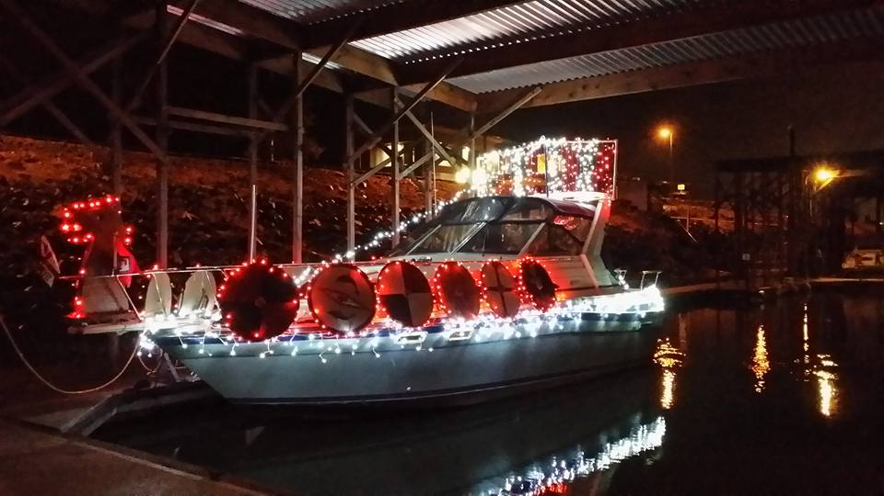
Tourism funding
Revenue Projections
Estimated Carry over to 2021 – 65,000
Lodging Taxes 2021 - $36,000
Interest & Miscellaneous - $500
Total Projected Revenue - $101,500
Expenditure Projections
Tourism Funding Grants - $35,000
Includes $11,625 unawarded funds
Highway Sign – CEDC –Webpage - $2,400
Total Projected Budget - $37,400
Applications will be accepted in March for additional funding requests.
Potential 2021 ending balance $64,100

Slide 6
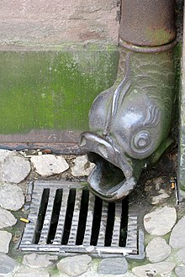
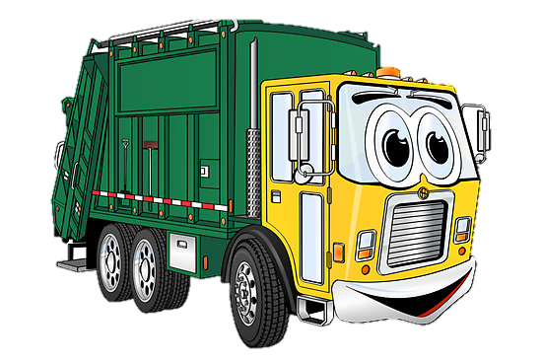
enterprise funds A type of proprietary fund in which the direct beneficiaries pay for all costs of the fund through fees
401 – WATER & SEWER OPERATIONS
FUND 402 – SOLID WASTE/GARBAGE
FUND 403 – STORMWATER
FUNDS 408 – 420 - WATER & SEWER RESERVES/ CAPITAL FUNDS

Slide 8
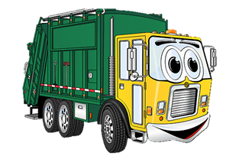
402 – SOLID WASTE/GARBAGE
PROJECTED REVENUES
Projected Carryover $25-30,000
Charges - $450,000
Utility Taxes – Streets/GFCF - $49,000*
State Tax - $16,200
Interest - $300
TOTAL PROJECTED REVENUES $516,000
With Carryover @ $25,000 = $541,000
*Note – Any changes in the Utility Tax rates would also effect these projections
PROJECTED EXPENDITURES
Operating Expenses - $44,7000
Collection – Waste Control - $383,000
Street Utility Tax - $27,000 – Capital funding
GFCF Utility Tax - $22,500*
Transfer to Streets for Maintenance – $25,000
TOTAL PROJECTED EXPENDITURE – $522,200
Revenues – Expenditure = (-$6,200) – Covered by projected carryover from 2020

Slide 9
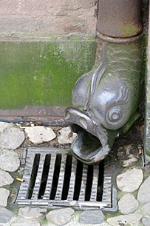
403 - Stormwater utility
PROJECTED REVENUES
Projected Carryover - $50,000
Rates/Charges - $120,000
Connection – SDC - $5000
Interest - $300
TOTAL PROJECTED REVENUES - $125,300
With projected carryover - $175,300
NOTE: If Council enacts 9.5% rate increase as recommended in the rate study - Rate Revenues will be increased by $11,400.
PROJECTED EXPENDITURES
Personnel with Benefits - $25,500
Operating Costs - $31,500
Loan Payment - $70,100
Capital Project - $30,000
TOTAL PROJECTED EXPENDITURES - $157,100
Revenues – Expenditures (-31,800) – may be reduced by rate increase and/or covered by projected carryover
Capital Project is to Evaluate the Conditions by Camera of Cedar Street.

Slide 11
The percentage of increase is for the 5 year period. In the wages category this includes 1.5 additional full-time positions added to the workforce, as well as contractual wage increases.

Slide 13
401 WATER – SEWER OPERATIONS
PROJECTED REVENUES – WATER
Rate/Charges - $1,600,000
Utility Taxes - $176,000
Labor/Parts/Connections - $232,500
Interest/Miscellaneous - $9,600
PROJECTED REVENUES – SEWER
Rates/Charges - $1,600,000
Utility Taxes - $176,000
Labor/Parts/Connections - $201,600
Interest - $500
TOTAL PROJECTED REVENUES - $3,996,200
Projecting only $100 – 150,000 carryover
Does not include any rate increase projections nor increase to connection fees
PROJECTED EXPENDITURES WATER/SEWER
Personnel/Benefits - $1,119,000
Utility Tax – General Fund – $192,000
GFCF Utility Tax - $160,000
Contracted Services-$408,700
Chemicals/Materials - $179,500
Operating Expenses - $205,900
Utilities – Electric/W&S -$224,500
State Taxes - $125,000
Capital Expenses from Operations - $14,000
Transfers to Ins – Audit-Benefit - $147,500
Connection Fees to Reserves - $400,000
Transfers to Equipment Reserve - $54,000
Transfer of Rate Revenue to Reserves-$900,000
TOTAL OF PROJECTED EXPENDITURES - $4,130,100
Revenues – Expenditures = -133,900

Slide 14
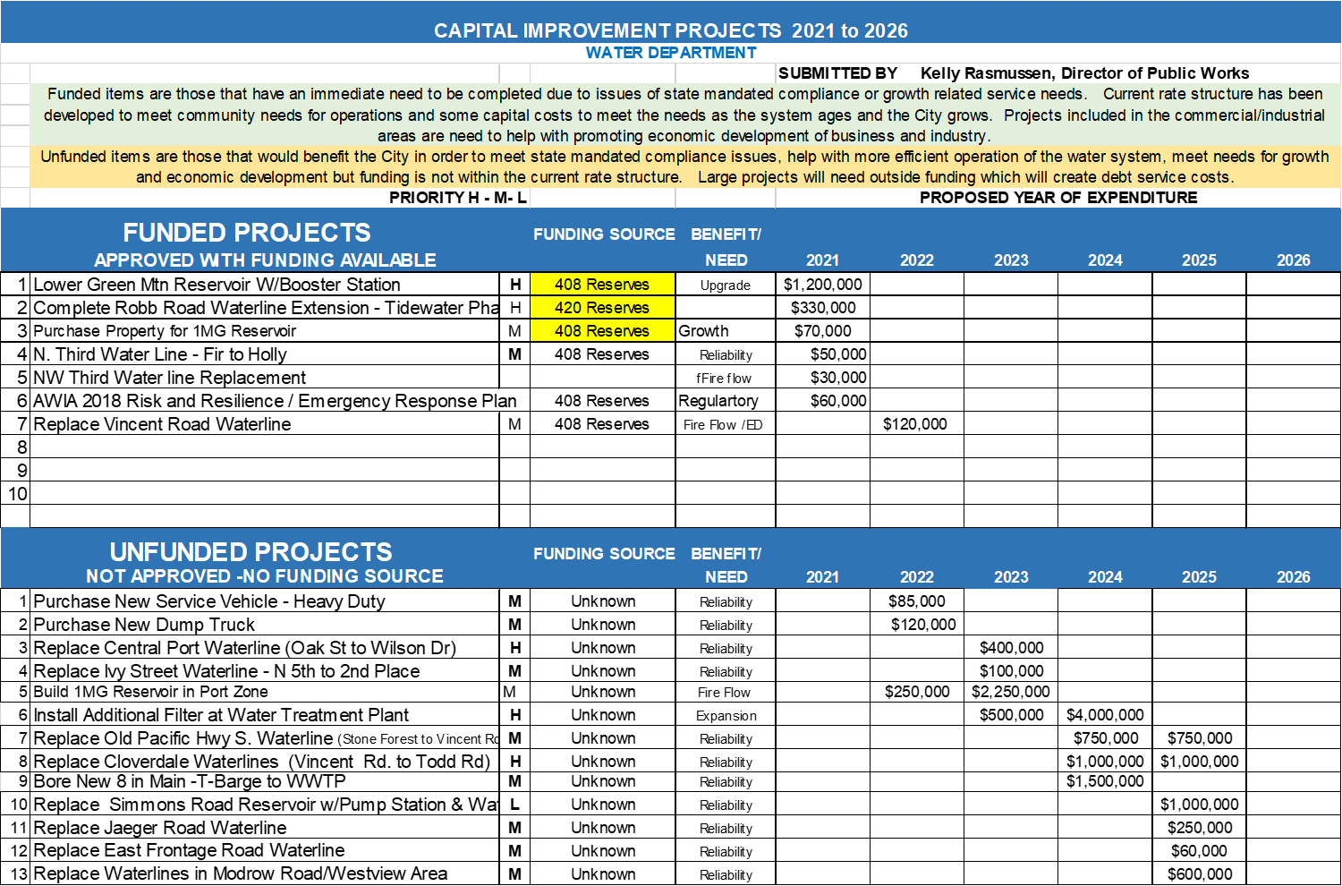

Slide 16
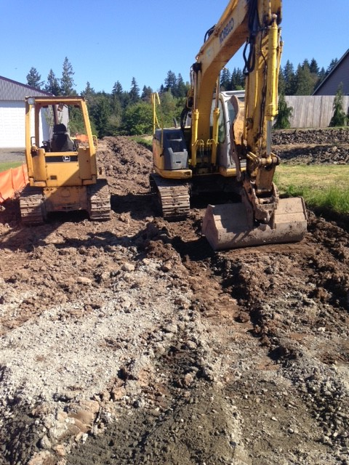
Water-sewer capital reserves
ADDITIONAL REVENUE FOR CIP
DWSRF Loan – $1,200,000 – 20year-1.7.5% for Green Mtn. Reservoir – future payments
County Funding – Received in 2020- $200,000 – included in projected reserve balance
PROJECTED RESERVE BALANCES
Water – $1,706,000
Sewer- $1,561,000
2021 FUNDED PROJECTS
Water Funds 408 & 420
Total $1,740,000
Sewer Funds 413 & 415
Total $65,000
Equipment Replacement - 410
Sewer – Grit Pump Replacement -$12,000
Meter Replacement - $40,000
Total of Capital Improvements in 2021 - $1,817,000

Slide 17
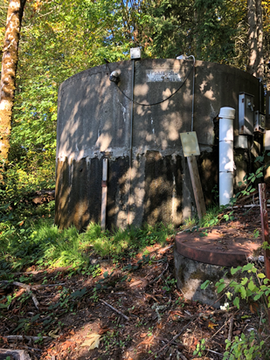
Water-sewer capital reserves
Projected Future Capital Projects 2022/2023
Water - $3,825,000 – Maintenance & Projects for Economic Development
(New 1 Million Gallon Reservoir – Water Plant Additional Filter – Waterline Replacements)
Sewer - $2,101,700 – Maintenance & Projects for Economic Development
(Old Sewer line Replacements – WWTP Equipment – Design for Plant Expansion)
Water Reserves
Projected Balance end of 2023 – (-$654,000)
Sewer Reserves
Projected Balance at end of 2023 - $1,494,300
Costs for future plant expansion $ 4,500,000
Equipment (vehicles/meters, etc) replacement costs are not included here.
This could be more or less depending on rate increases – Operations would decrease the funds being transferred for Capital projects if the revenues do not support the expense of operations.

Slide 19
Questions???
The projections for revenues are incomplete until the decision regarding increases to rates is made. Public Hearing on the rate options later tonight
Water & Sewer Operations has a shortfall at this time
There is reserve and loan funding for the projects set out as funded for 2021.
Second Public Hearing on 2021 Budget and 2021-2026 CIP – December 3, 2020 @ 7pm.
Will cover any changes to these projections and the budget for the Library, Streets, Special Revenue Funds and the General Fund.

